Slide 1

Update On Centire Project
Bipendra Basnet

Slide 2
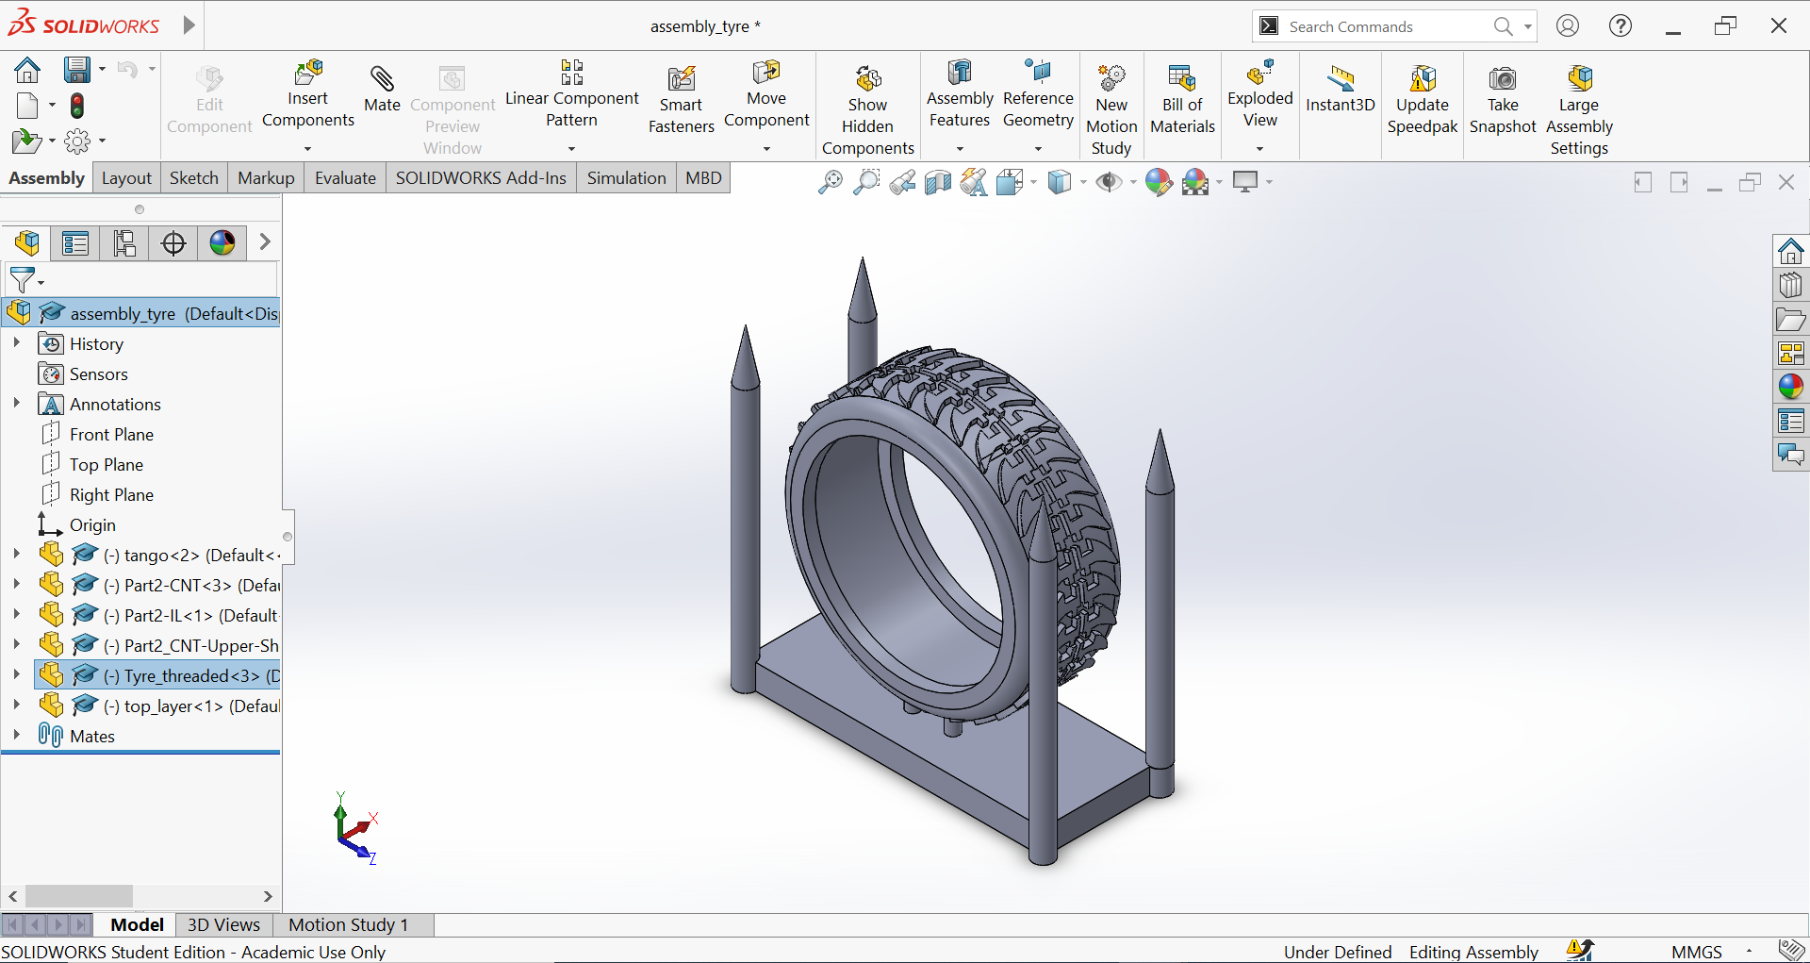
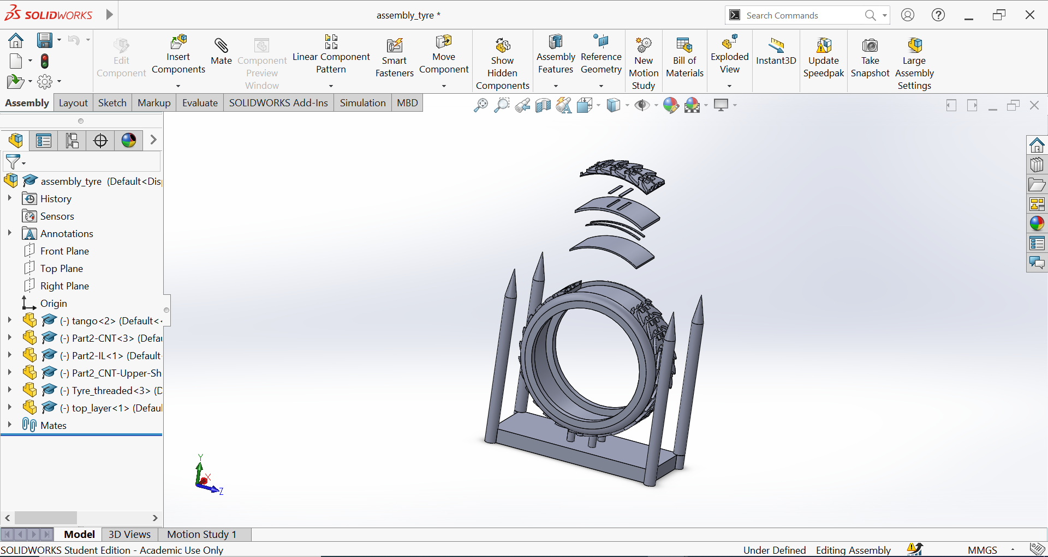
Designed and Fixed Substrate for Print
Layers From the Top (Exploded View) | Thickness (mm) | Dimension (mm)
Tango With Tire Threads | 0.5 | 30 *50
CNT | 0.5 | 2x20
IL with CNT slots | 1.5 | 30x50
CNT | 0.5 | 2x30
Tango Base | 1 | 30x50

Slide 3
Next Objective
Change the design to make the tire removal
Printing the sensor on tire

